Slide 1
Analysis, Design and Implementation
Topic 5:
Dynamic Analysis and Design
Notes:
NCC Education - Title Master

Slide 2
Introduction
  In the last lecture we looked at building static models of the systems we are to build.
    The class diagram focuses on how things fit together.
  Today, we are going to look at an aspect of the dynamic design.
    How a system should respond to users and evolve over time.
  This involves two new diagram notations:
    Sequence diagrams
    Activity diagrams

Slide 3
Activity Diagrams
  Activity diagrams are known as workflow diagrams.
  They are much like flow-charts, except more structured.
  Activity diagrams are used to describe the full process behind an internal process or a user request.
  They describe the logic of the operations that are shown on class diagrams.
  They are constructed of a number of notational elements.

Slide 4
Notational Elements - 1
Element | Description
Swim Lane | Used to indicate which actors or objects are responsible for the action. They are indicated by a series of lines partitioning the diagram.
Initial Node | The starting point for the diagram. This is represented by a single filled circle.
Activity Final Node | The termination point for the activities. There may be several of these in a diagram. This is a filled circle surrounded by a border.
Flow | The flow represents the order in which activities are performed. Indicated by arrows.

Slide 5
Notational Elements - 2
Element | Description
Fork | A fork indicates parallel processing – activities that can be undertaken at the same time. A fork is indicated by a thick bar where one flow enters and multiple flows leave.
Join | A join indicates the end of parallel processing, and is indicated by a thick bar where multiple flows enter and only one leaves.
Decision | A decision represents a choice that must be taken, and is represented as a diamond with a single flow entering and one or more flows leaving.
Activity | An activity is the baseline step in an activity diagram, and is represented by a rounded oval. An activity is any logically discreet action that must be taken throughout the course of the overall activity.

Slide 6
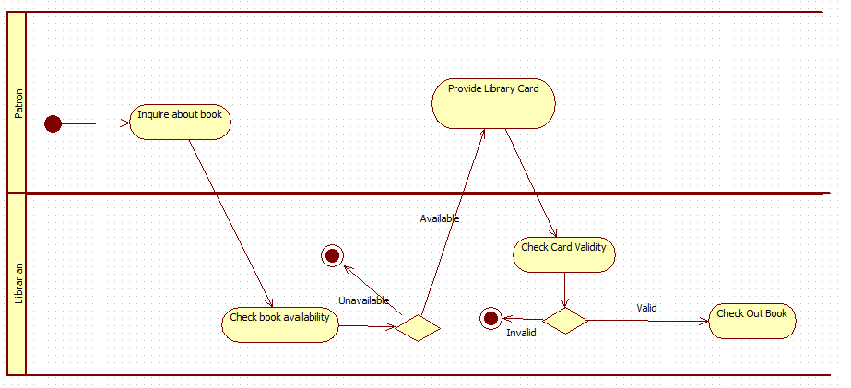
Activity Diagram

Slide 7
Activity Diagrams
  Activity diagrams are mostly used for two purposes:
    Outlining the high level activity in a system (as with our example diagram)
    Formally representing algorithms (each activity becomes a line of code)
  In the latter case, activity diagrams serve as a consistent notation for representing logical processes (like pseudocode, but graphical).

Slide 8
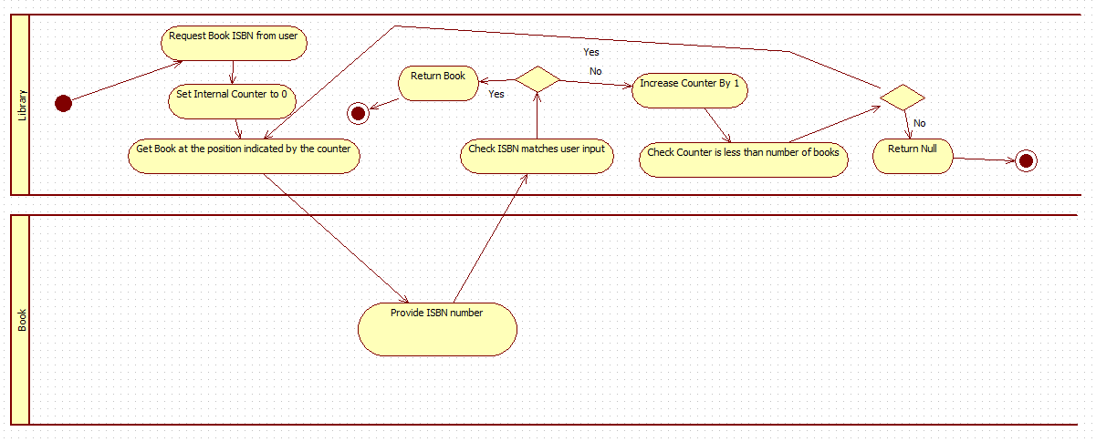
Finding a Book

Slide 9
Creating an Activity Diagram
  Creating an activity diagram is much like writing computer code.
    There is no ‘right’ way, but plenty of wrong ways.
  Activity diagrams represent the flow of communication through a system.
    It is important that each use case in your use case diagram has an activity diagram representation.
  Activity diagrams can be profitably developed in two parts.

Slide 10
Creating an Activity Diagram
  Analysis
    Understand what the current system is doing
    Understand the flow of communication for each distinct use case in the current system.
  Design
    Improve the existing system
      Improve efficiency
      Remove bottlenecks
      Remove redundancies
    Diagram your improved workflows.

Slide 11
Understanding the System
  As with constructing a class diagram, the important thing is to understand your brief.
  Diagramming the workflow of a process will ensure that you understand each of the steps.
    Having someone else try to follow your diagram will ensure that you haven’t left anything out.
  The NLA processing that you may have done to outline the class diagram will assist in developing your activity diagrams.

Slide 12
Understanding the System
  Your NLA will reveal:
    Behaviours
    Classes
  Your use case diagrams will reveal:
    Processes
    Actors
  The development of one diagram should be informing the development of others.
    UML is an integrated system for developing diagrams.

Slide 13
Developing an Activity Diagram
  A useful first step is to outline a process in structured English or pseudo-code.
  You do not need all of the detail to begin with.
    As with class diagrams, we can continually refine these as we go along.
  Once you have a structured description of the process, construct the diagram from that description.
  Granularity can be difficult here.
    It’s often tricky to pick the right level of detail for individual pseudo-code statements.

Slide 14
Developing an Activity Diagram
  The process for constructing your description is as follows:
    Identify the process to be documented.
    Limit the scope of the process only to the relevant aspects.
    Methodically document each step of the process:
      When a decision is called for, precisely enumerate all options.
      When a repetition is called for, precisely enumerate the termination condition.
      When an activity is called for, break it down until each box represents one distinct step of the system.

Slide 15
Implementation - 1
  Activity diagrams lend themselves easily to code.
    It is simply a case of translating activities into code statements.
  Activity diagrams are focused at the level of the method.
    They don’t show big picture detail of how things interact.
  Consider the example activity diagram that looks to see if a book is currently available - we can convert that easily into an suitable OO language.

Slide 16
Implementation - 2
  As with any of these diagrams, they represent a high level, language independent view.
    We need to make calls on implementation as we go along.
  Our activity diagrams don’t explicitly mention loops, so we need to decide for ourselves how to implement the looping behaviour.
    (We’ll do ours with a for loop)
  We begin by writing the logic out in full, and then condense.

Slide 17
Implementation – Rough
Book findBook (String isbn) {
int counter;
Book tmp;
String currentIsbn;
counter = 0;
tmp = allBooks.get(counter);
currentIsbn = tmp.getISBN();
if (currentIsbn.equals(isbn)) {
return tmp;
}
counter += 1;
if (counter < allBooks.size()) {
// Loop back to line 8
}
return null;
}

Slide 18
Implementation - Refined
Book findBook (String isbn) {
int counter;
Book tmp;
String currentIsbn;
counter = 0;
for (counter = 0; counter < allBooks.size(); counter += 1) {
tmp = allBooks.get(counter);
currentIsbn = tmp.getISBN();
if (currentIsbn.equals(isbn)) {
return tmp;
}
}
return null;
}

Slide 19
Implementation - 3
  Implementation at this level of abstraction is often, at least in part, an all or nothing affair.
    We can’t implement the findBook method until we implement the getISBN method.
  We develop such programs from the fundamentals upwards:
    Accessor methods are implemented first
    Those methods that rely only on accessor methods are implemented next
    Those methods that rely on other methods are done last.

Slide 20
Sequence Diagrams
  The next diagram notation we will discuss is that of the sequence diagram.
    This shows the order in which methods are invoked in a system.
    It shows the scope, or lifetime, of objects.
  Sequence diagrams are useful for developers to see the big picture of how things interact.
    It views the operation at a higher level of abstraction than an activity diagram.

Slide 21
Sequence Diagram Notation
  Sequence diagrams consist of a number of lifelines.
    These are boxes that represent the roles and lifetimes of objects involved in an interaction.
  Each of these life-lines will produce messages.
    These are labelled arrows that show the name of methods invoked and their parameters.
  Return messages are drawn with the type of the parameter, and a dotted arrow.

Slide 22
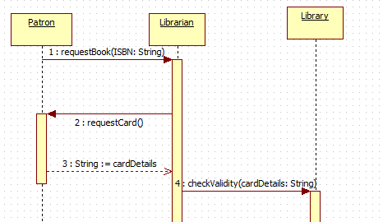
Sequence Diagram

Slide 23
Guards and Alternates - 1
  The flow of logic through a sequence diagram is often dependent on the state of returned values.
    Card validity
    Book availability
  We represent these in a sequence diagram through the use of a frame.
    This allows us to provide if/else strutures in our diagrams.
    We place a guard condition on the frame which determines whether a frame should be executed.

Slide 24
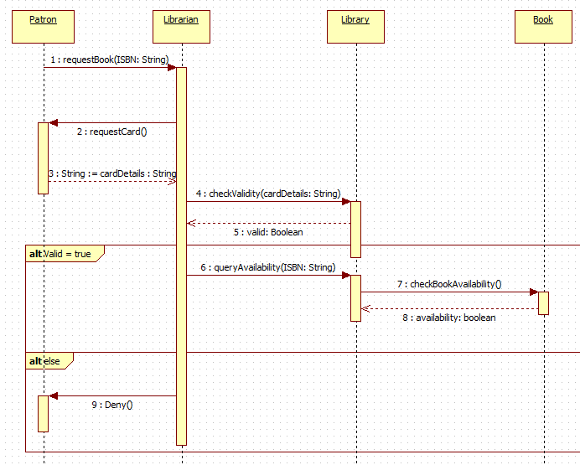
Guards and Alternates - 2

Slide 25
Objects and Classes
  In a sequence diagram, the boxes at the top of a lifeline represent objects, not classes.
  As such, they should properly be named and typed.
    Names are of secondary importance unless we can be sure of a particular context.
  We name them anyway so that we can distinguish between instances of a class and potentially static operations (in which case, we have the type only).

Slide 26
Sequence Diagrams
  Sequence diagrams are not usually implemented directly.
  They serve to help you find logical or architectural inconsistencies before it becomes time to develop the program.
  They also show dependencies of objects and methods.
    You can see what activities are going to be involved in a process by examining the sequence diagram.

Slide 27
The Role of a Sequence Diagram - 1
  Activity diagrams should represent a code view of a system.
  Sequence diagrams should represent a higher level view of interactions. Otherwise, you gain nothing from them that you don’t gain from looking at the source code or the activity diagrams.
  There is no need for a sequence diagram to be detail heavy.
    Broad strokes allow you to get the most out of them.

Slide 28
The Role of a Sequence Diagram - 2
  Sequence diagrams also serve as a way to co-ordinate interfaces between multiple developers.
    If everyone has access to the sequence diagram, they can see what methods their classes need to expose and what data they are expected to return.
  Sequence diagrams are a useful part of your analysis and design toolkit, but not necessarily a part that will inform the implementation of your systems.

Slide 29
Conclusion
  Dynamic modelling represents the state of the system as it changes over time, or as it reacts to user input.
  Activity diagrams serve as a template for implementing code.
    They are a low-level view of how processes and objects interact.
  Sequence diagrams are a high level planning and design tool.
    They don’t get implemented directly.

Slide 30
Topic 5 – Dynamic Analysis and Design
Any Questions?
Notes:
NCC Education - End Slide Master

